Slide 1
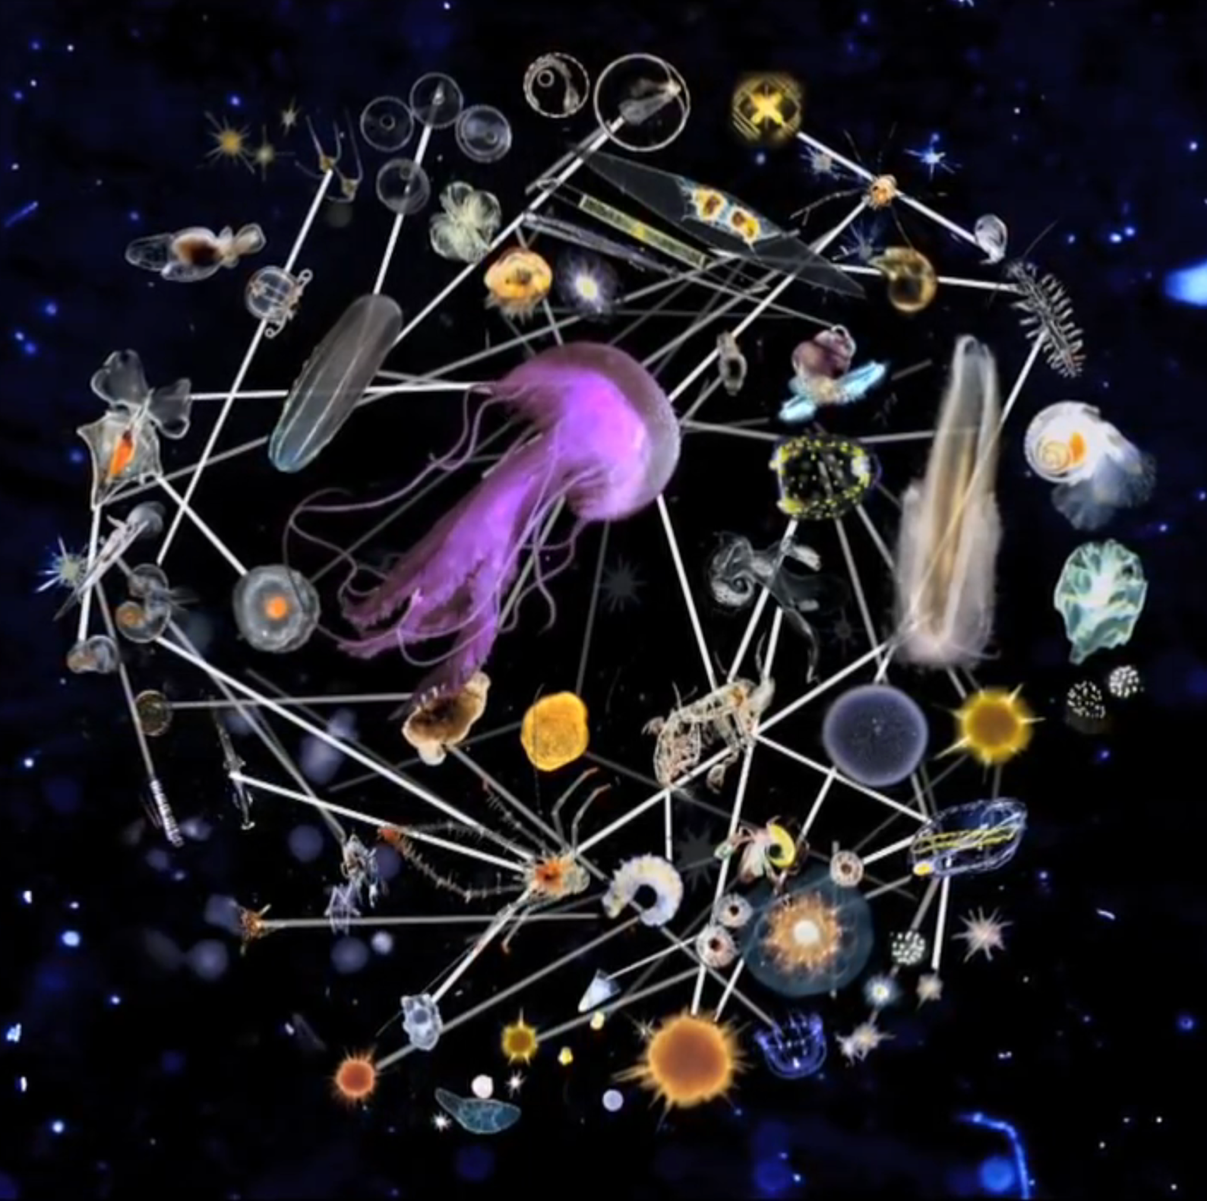
Welcome

Slide 2
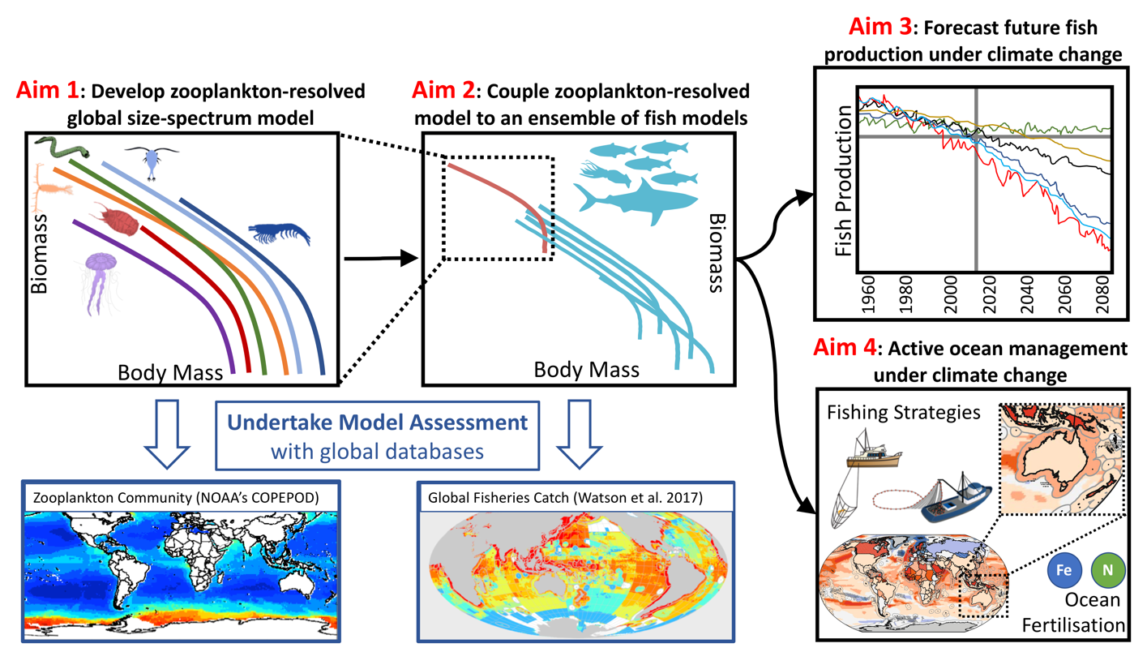
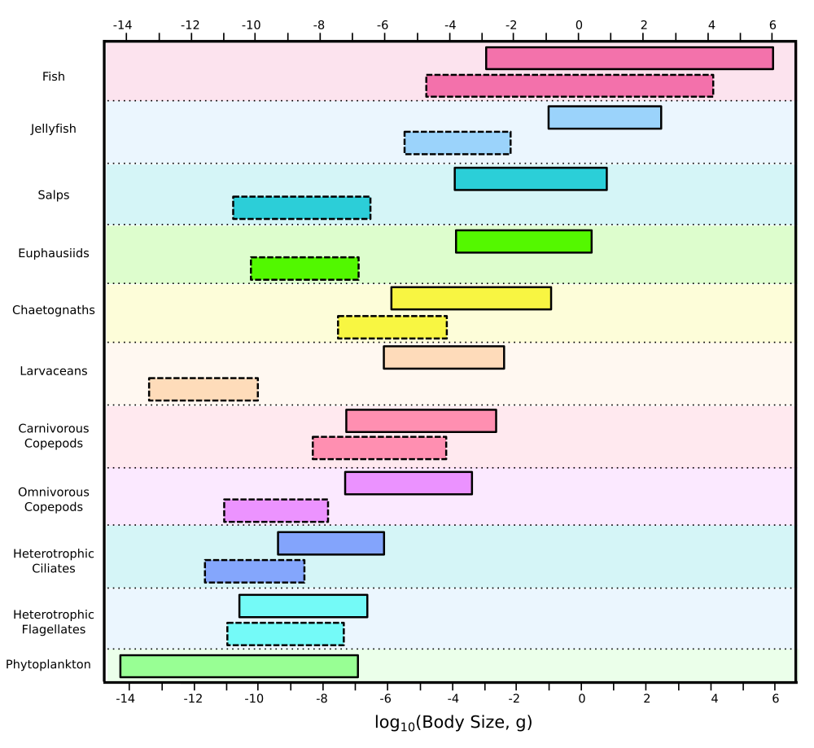
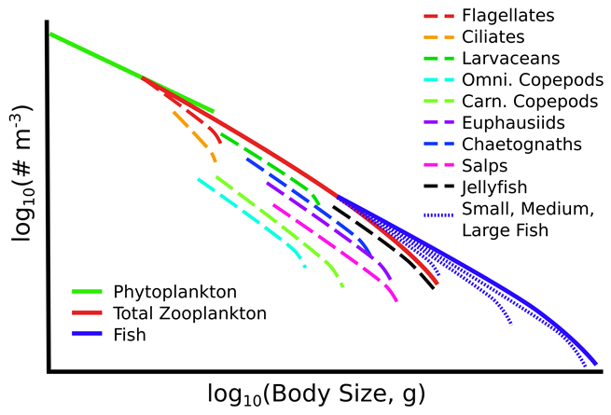
Intro. & Overview (Ant)

Slide 3
Proposed outcomes from today
Develop our portfolio of projects in the DP – led by students and us
What are the key aspects that each of us want to lead?
Low hanging fruit – “The pivotal role of zooplankton in global fisheries production”
How do we best collaborate with FishMIP?

Slide 4


Slide 5
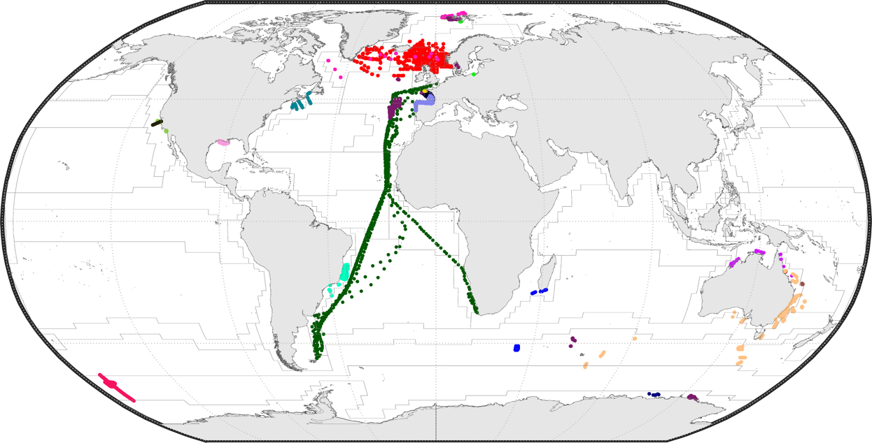
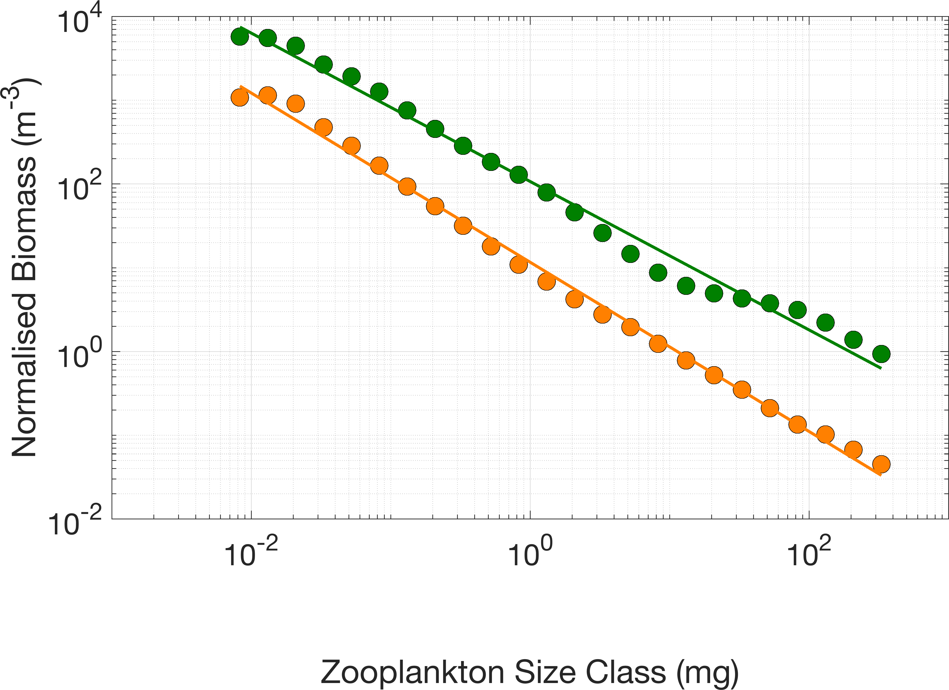
Slope: Eutrophic vs Oligotrophic
Eutrophic (-0.98)
Oligotrophic (-1.01)

Slide 6
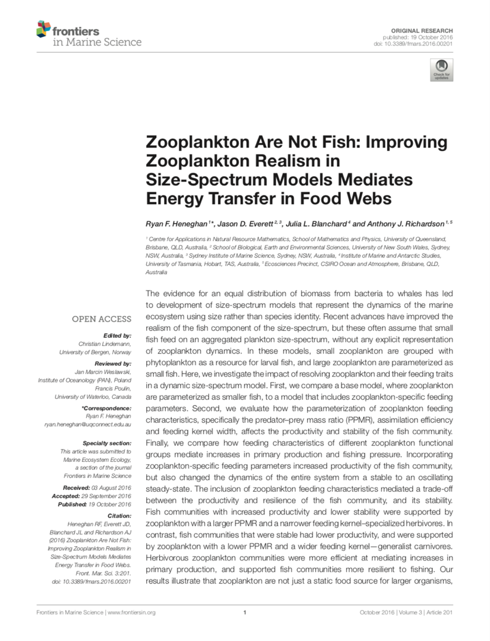
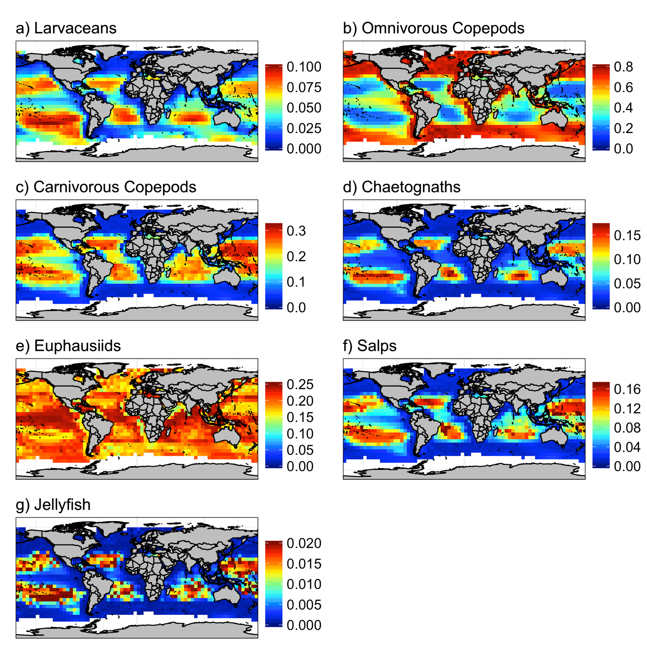
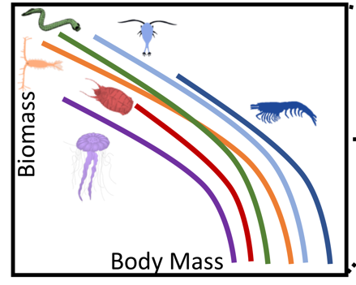
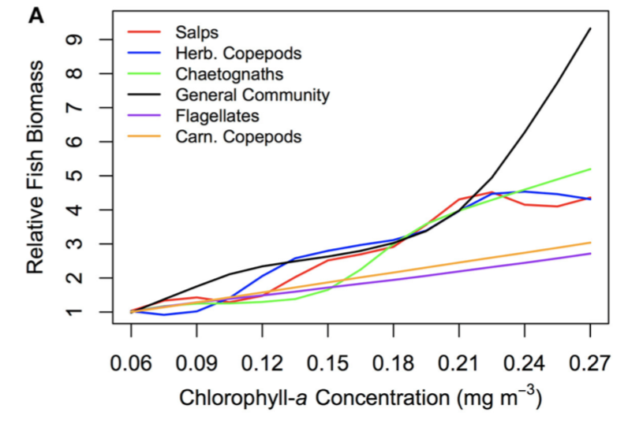

Slide 7
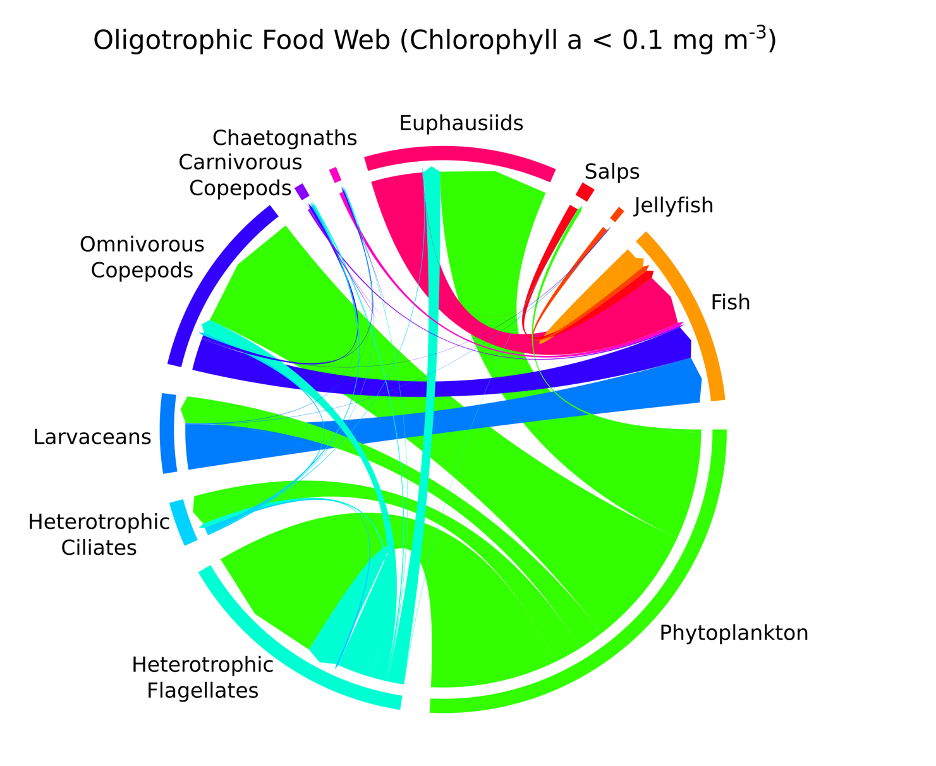
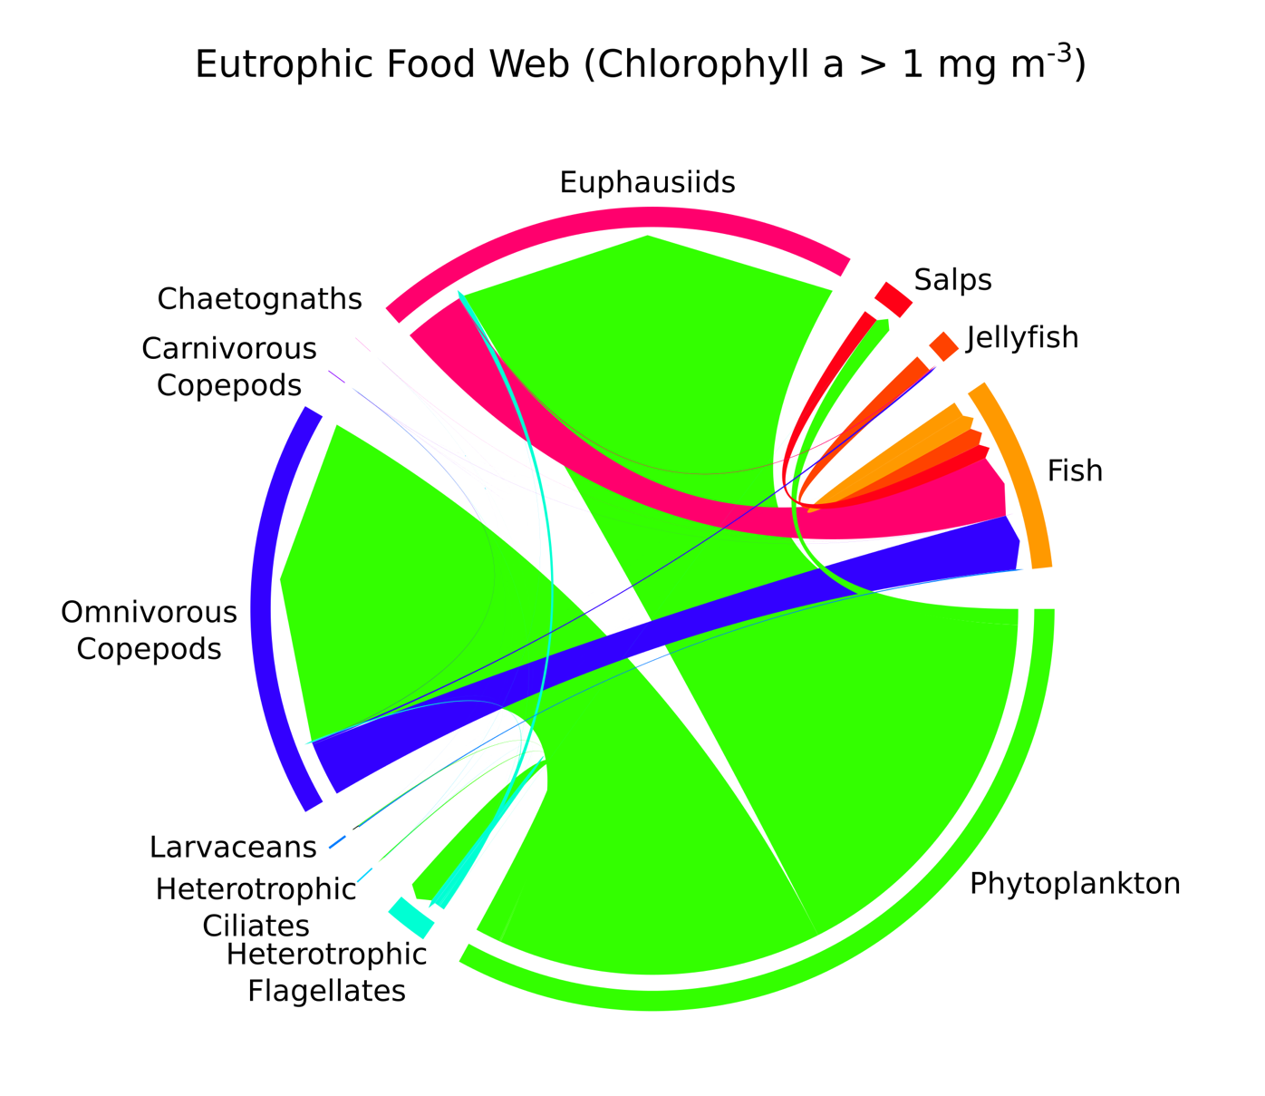
Similar slopes, but energy moves differently

Slide 8
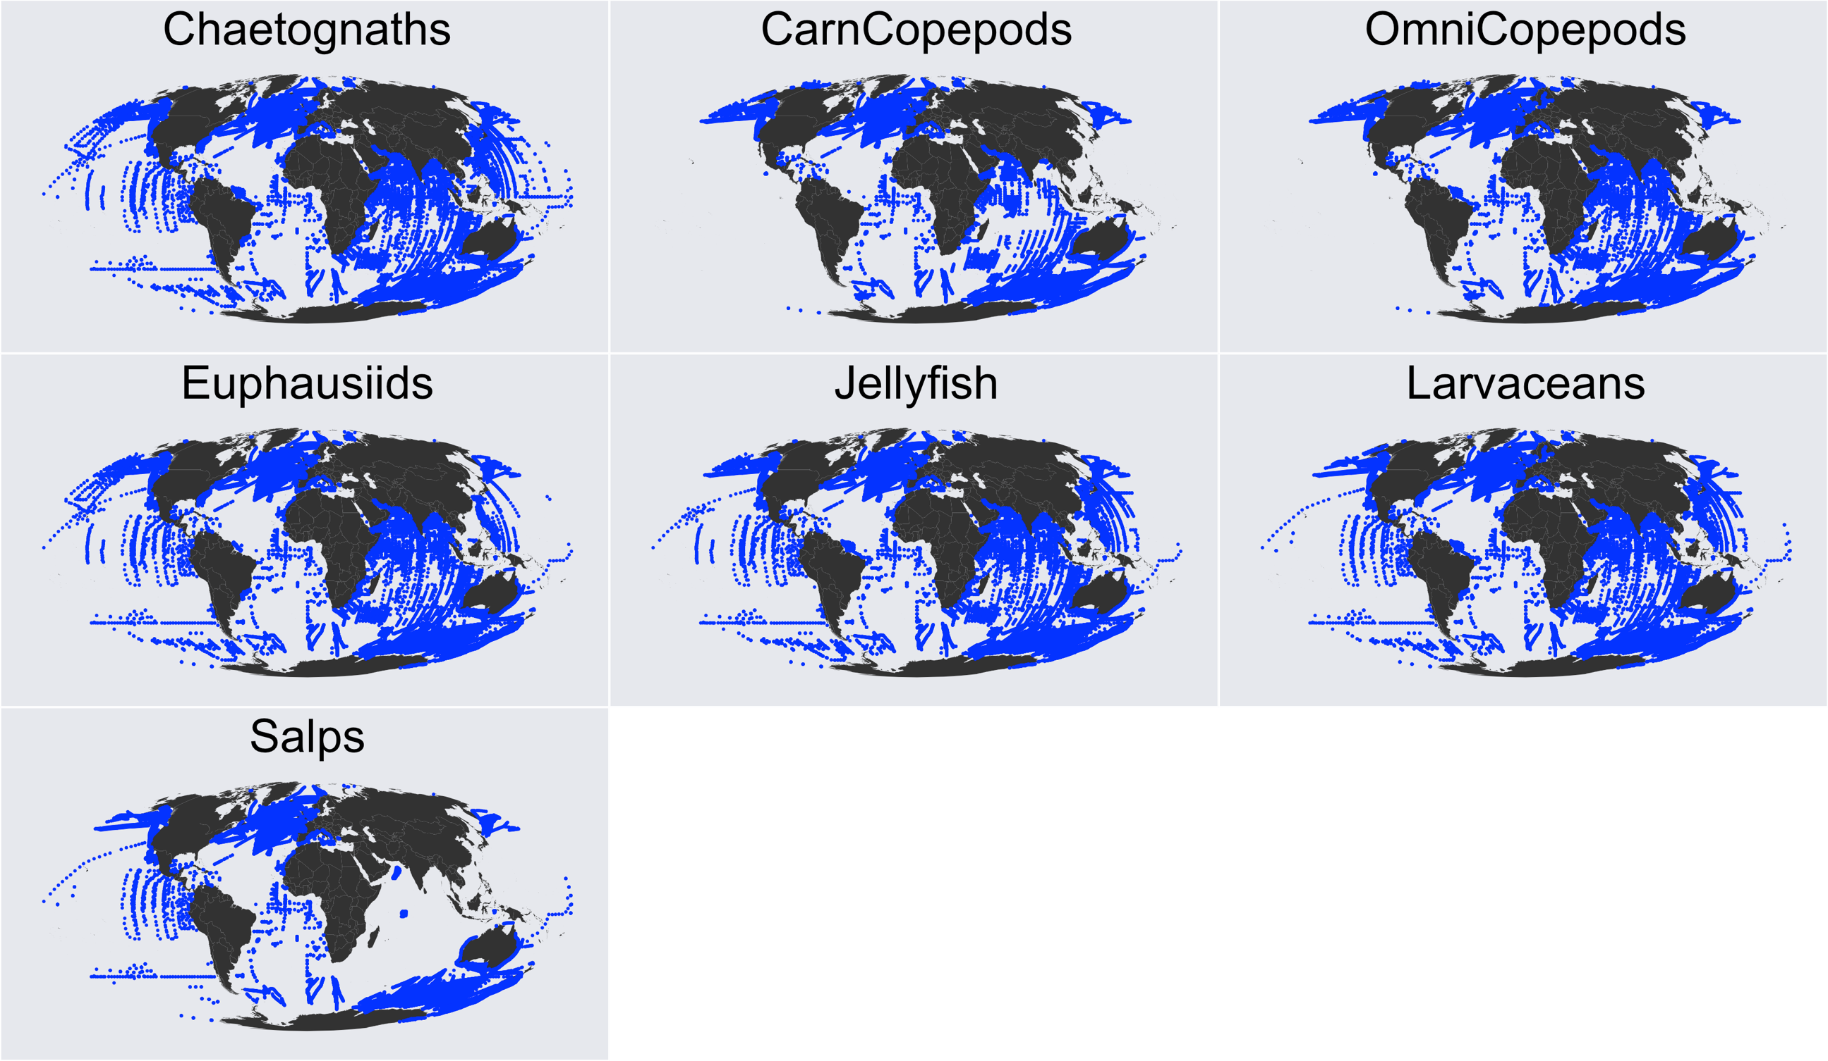
COPEPOD
IMOS
SAHFOS
GLOBEC
JeDI
L4

Slide 9
GAM: Omnivorous Copepods

Slide 10
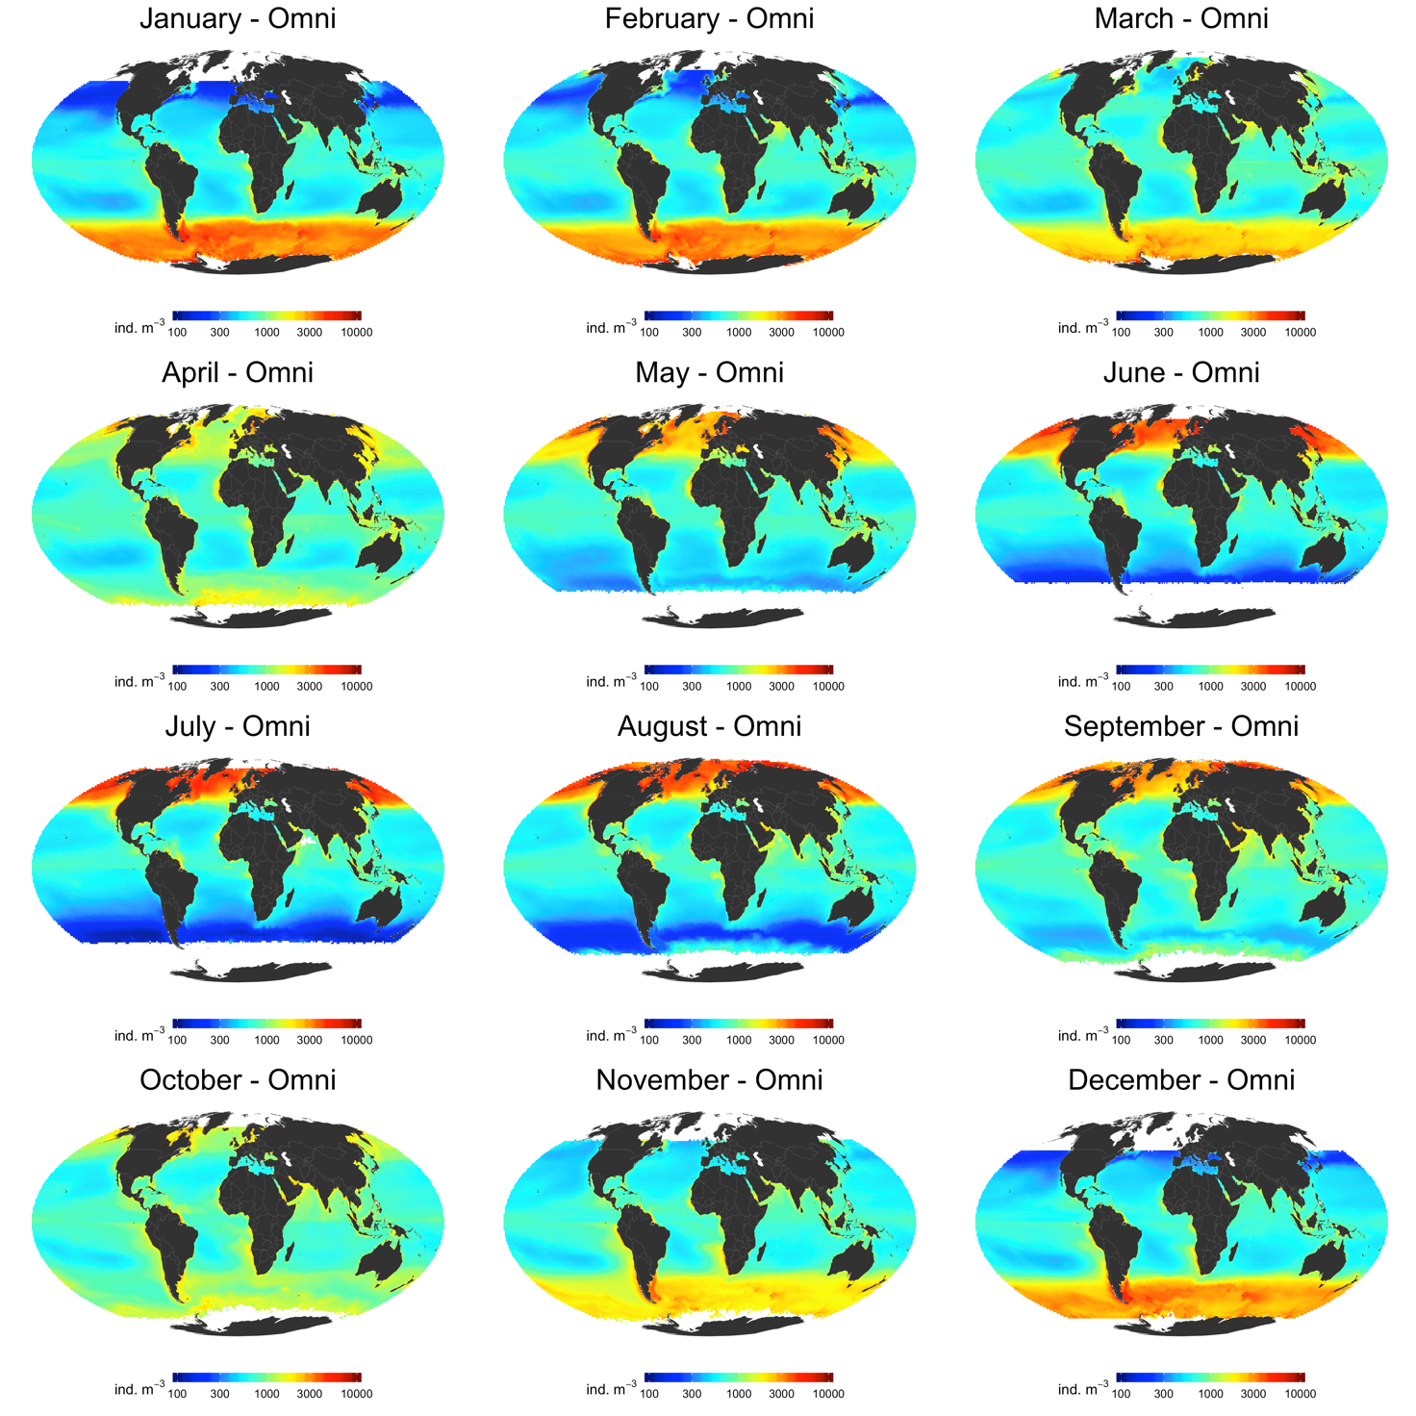
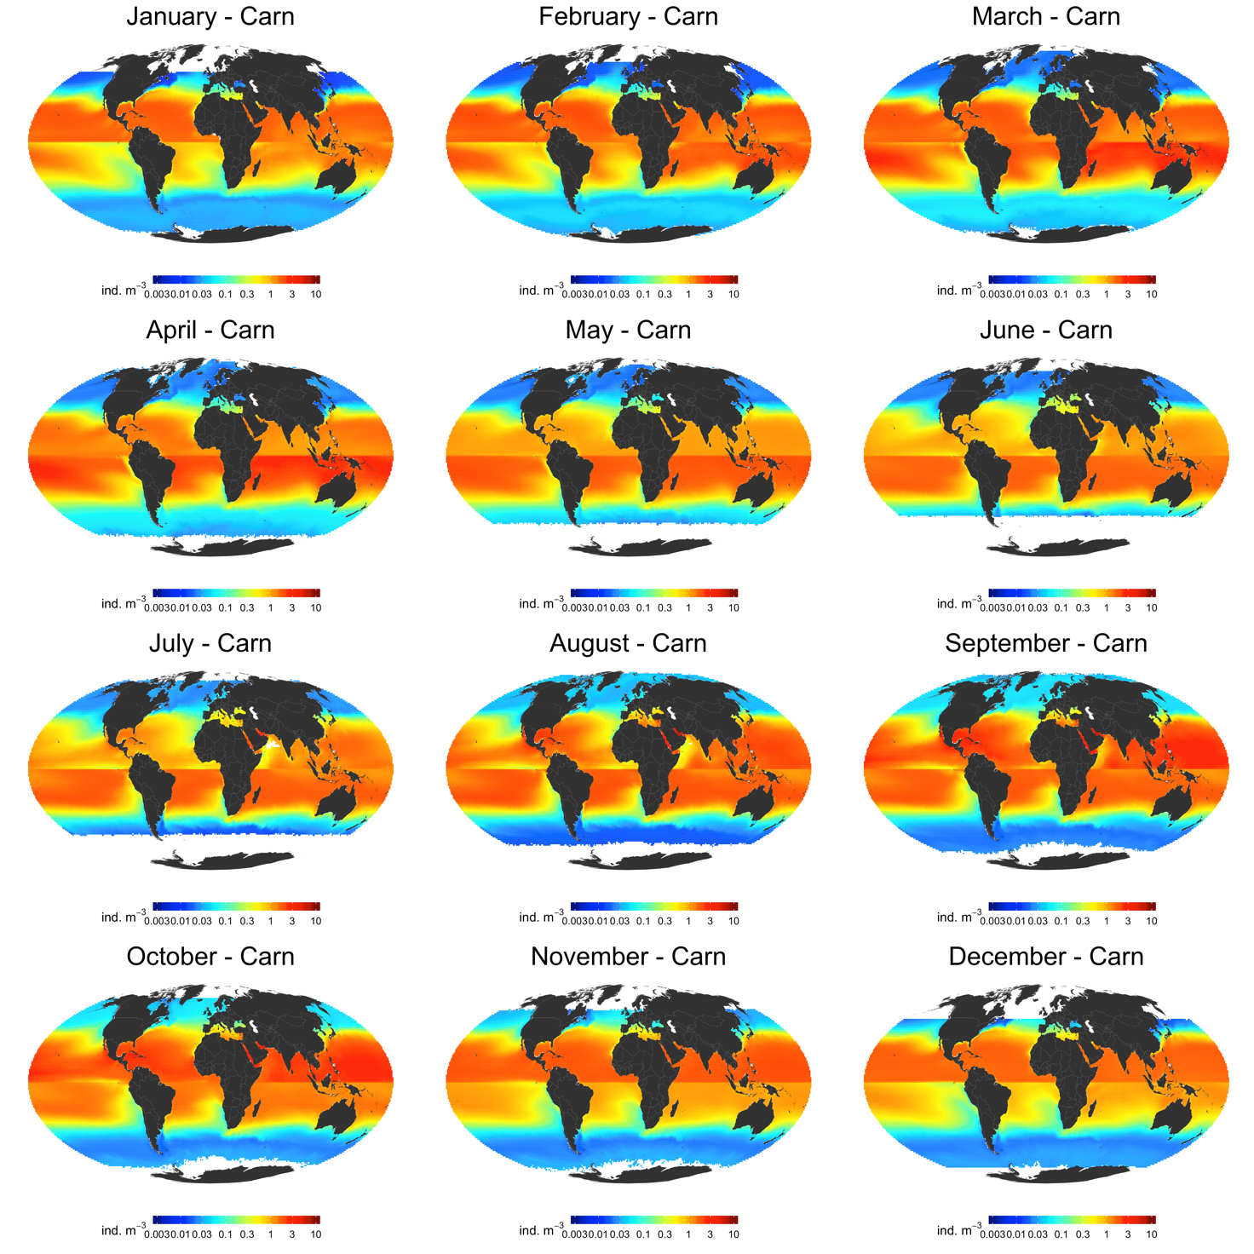
Omnivorous Copepods Carnivorous Copepods

Slide 11
Key Questions/Thoughts
How are the huge tuna and billfish fisheries supported in relatively oligotrophic waters?
Do Z typically amplify the changes in P? Does this vary seasonally?
What is the relative efficiency of oligo v eutro?
What are our best estimates of regional and global fisheries production and how do they compare with other estimates?
How could global F prodn change in the future?
What role does Z play in C export? How will it change in the future
Which countries are winners and lovers from CC wrt Fisheries?
What could be the effect of geoengineering or ocean fertilization on C export of fisheries
Does fishing differentially promote/hinder C export?
Global Z Biomass + Fish + functional groups

